Slide 1
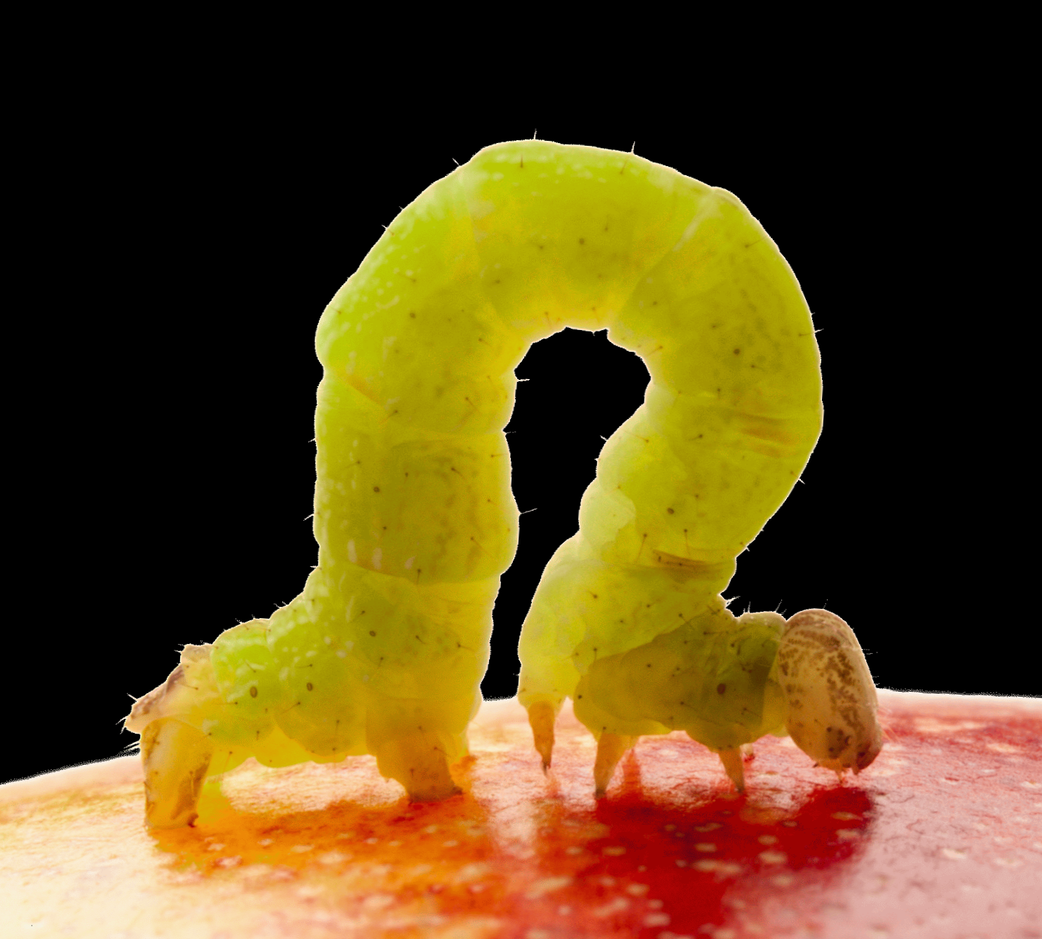
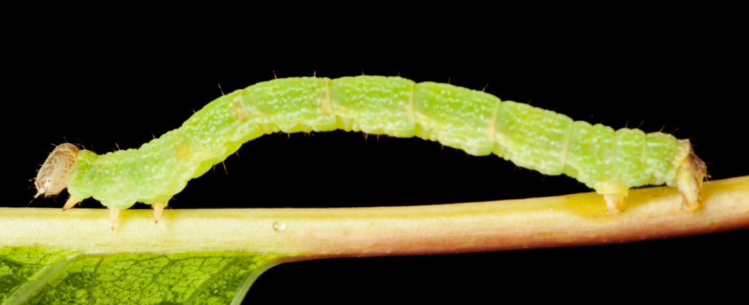
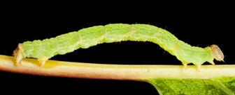
Inchworm Plots
Visual Representation of Inferential Uncertainty
Dale Rhoda
Biostat Global Consulting
Notes:
Abstract:
This talk introduces a new graphic for inference and a Stata program to construct it.
When policymakers and other lay audiences internalize inferential results they often ignore the measure of precision or uncertainty that accompanies a point estimate. Doing so can lead to inefficient action (or inaction). Different organizations take different approaches to this problem in their reports. Some list point estimates alone. Others list a confidence interval (CI) or make it available in an annex. Some plot a CI using a 1D representation.
The 2015 WHO Vaccination Coverage Cluster Survey Reference Manual recommends a new graphic called an inchworm plot that represents results with a 2-D distribution, highest near the point estimate and lowest at the ends of the central 95% CI. Each distribution includes ticks to represent bounds for strong one-sided inference. When results for several strata are shown together, the area of each distribution is scaled to be constant; precise estimates look like tall inchworms, poised to take a step and those less precise are wide and short, like worms outstretched.
The talk highlights figure features and potential to represent uncertainty in a manner than can be absorbed by laypersons without insulting (or taxing) their intelligence.

Slide 2
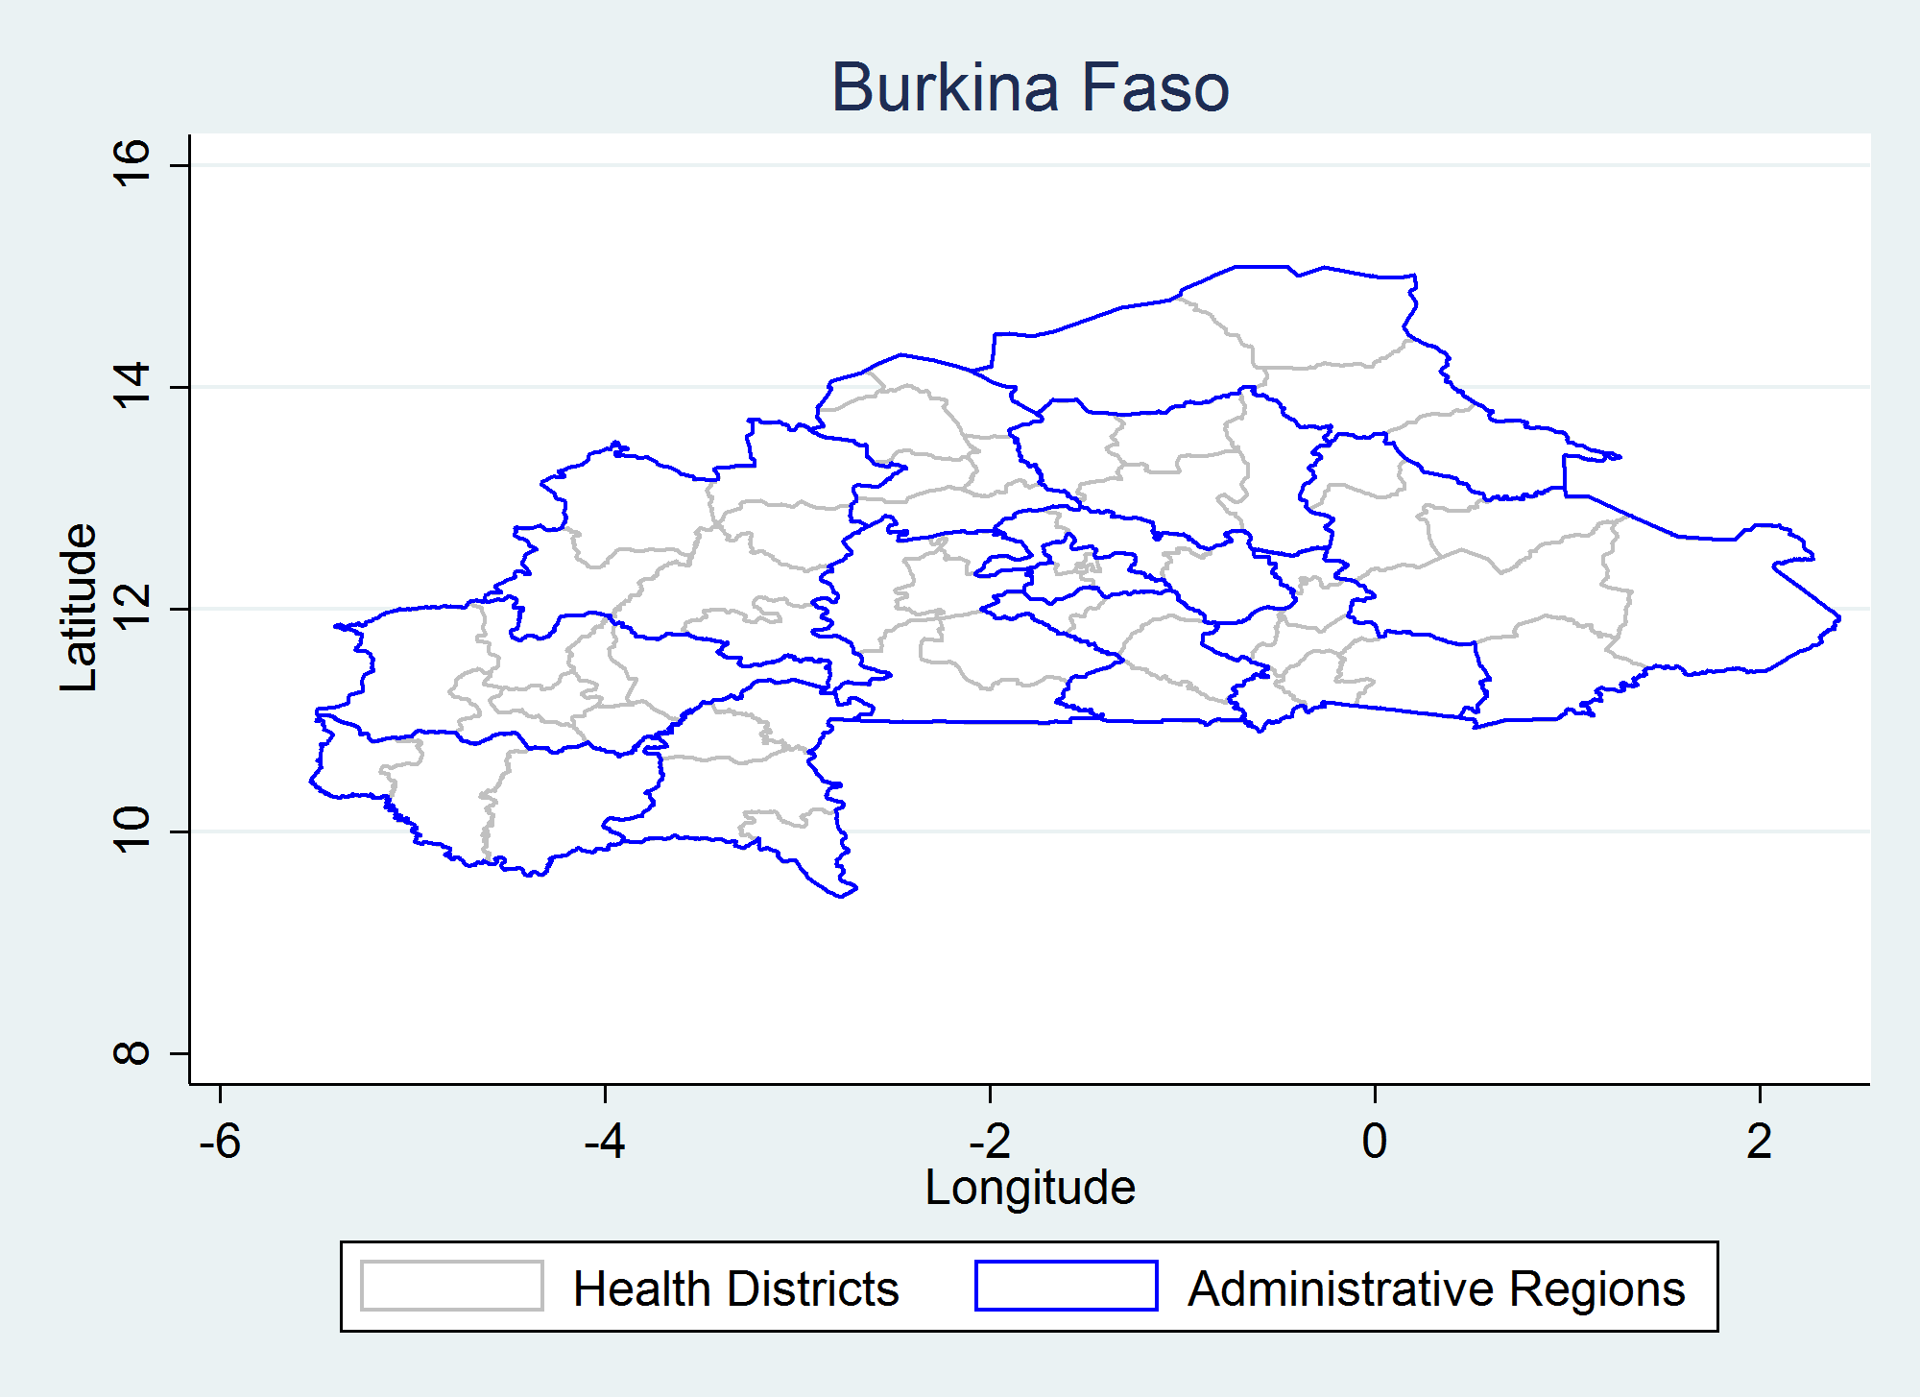
Context
Survey inference
Complex sampling
Nested strata
Estimate population proportion
Notes:
The material I present today will be in the context of inference from a complex survey sample (stratified clustered surveys) and the outcome of interest is a proportion. But broadly speaking what I will show could be used in other contexts…outcomes could be means or totals and it could be from any sample…a simple random sample as well as a complex survey sample.
Here’s a map showing the 63 health districts in Burkina Faso, nested among 13 administrative regions, nested within the country. In the field of vaccination coverage (prevalence) we are often doing inference at three nested levels like this, so of course the sample size in a district is small compared to the aggregated sample size in a region or across the entire country.

Slide 3
Challenges
Policy-makers treat sample as if it were a census
They focus exclusively on point estimates
Tend to classify strata using point estimates
Several important surveys omit confidence interval (CI) & bounds from body of report
But robust classification should be based on confidence bounds, not the point estimate
Notes:
Both the UNICEF Multi-Indicator Cluster Survey (MICS) and the USAID Demographic and Health Survey (DHS) omit measures or representations of sampling error from the main body of their reports. They each provide an appendix with some sampling error info, but it is not adequate or intuitive for conveying all that concerns me to the reader of the report.

Slide 4
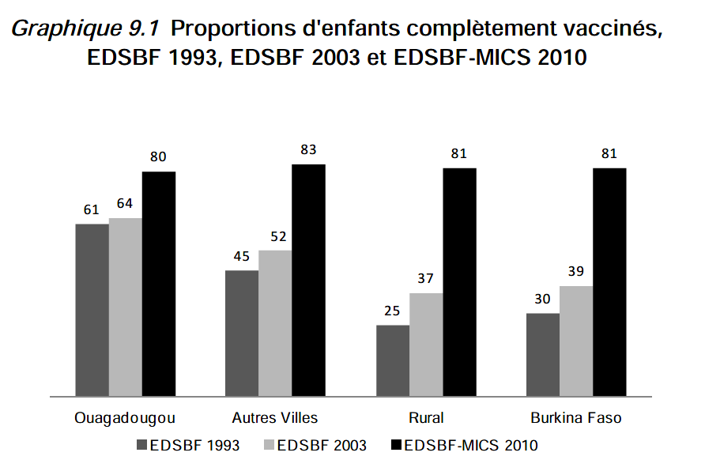
Example: % children completely vaccinated
Source: Burkina Faso 2010 Multiple Indicator Cluster Survey (MICS) Report, UNICEF
Notes:
Here’s a table from a MICS report. Results are being reported for strata of considerably different sizes here…Ouagadougou is the capitol city on the far left and the results on the right are for the entire country. Perhaps these samples are all large enough that the sampling error is very small, but results are sometimes listed together for strata with small samples and strata with large samples and it is not easy for the reader to assess uncertainty in the estimates.

Slide 5
But CI widths vary substantially due to:
Differences in estimated coverage (wider near 50%)
Differences in sample size
Differences in spatial heterogeneity of outcome (characterized by intra-cluster correlation coefficient: ICC)
Other differences that might roll into design effect: DEFF
Notes:
Well…you might say…as long as the sample size is listed then you have some idea what the confidence interval (CI) is like. But it’s not that simple. First, a statistician might hazard a reasonable guess, but policy-makers will probably not want to even try. Second, the sample size does NOT determine CI width for the reasons listed above. You can have two samples of the same size with the same estimated proportion and one can have a substantially wider CI than the other.

Slide 6
Reminder
In a complex sample the actual sample size is often larger than the effective sample size
Effective sample size (ESS) = Simple random sample N that would yield the same variance as the actual N
Ratio of actual to effective sample size = N/ESS = design effect (DEFF)
DEFF ≅ 1 + ( m – 1 ) ICC where m = avg N per cluster & intracluster correlation coefficient (ICC) varies from -1 to 1 (but usually from 0 to 1)

Slide 7
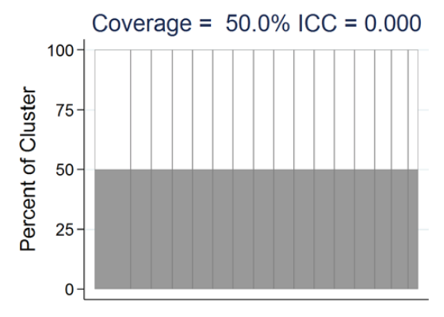
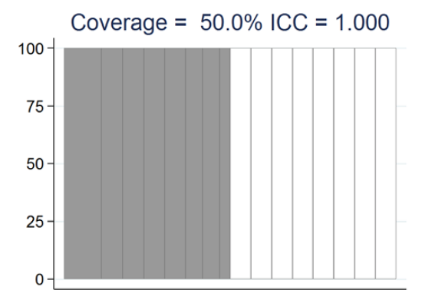

DEFF ≅ 1 + (m-1) ICC
Notes:
Here’s an example…two samples of precisely the same size: N=210. In the first instance, half the kids sampled in every cluster were vaccinated. (Post presentation note: I should have used m=6 or m=8 in the example because it’s impossible to find that exactly half of 7 kids were vaccinated…but let’s gloss over that for a moment…) But there is no spatial heterogeneity in prevalence…all clusters have 50% vaccination, so the ICC is 0 and the effective sample size is equal to the full value of 210. In the second instance, in half the clusters, ALL the kids sampled were vaccinated and in the other half, none of the kids sampled were vaccinated. This yields an ICC of 1 which yields a design effect of 7, and the effective sample size is 30 even though the actual sample size is 210.
This detailed example is to show that reporting the estimated proportion and the actual sample size is not sufficient to imply what the width of the CI will be. It can vary substantially.

Slide 8
Uncertainty matters
For classification: % in Stratum A is likely to be above XYZ threshold
For comparison: % in Stratum A is likely higher than in Stratum B
And it is not possible to guess where the confidence bounds lie if only point estimates & N appear in the report

Slide 9
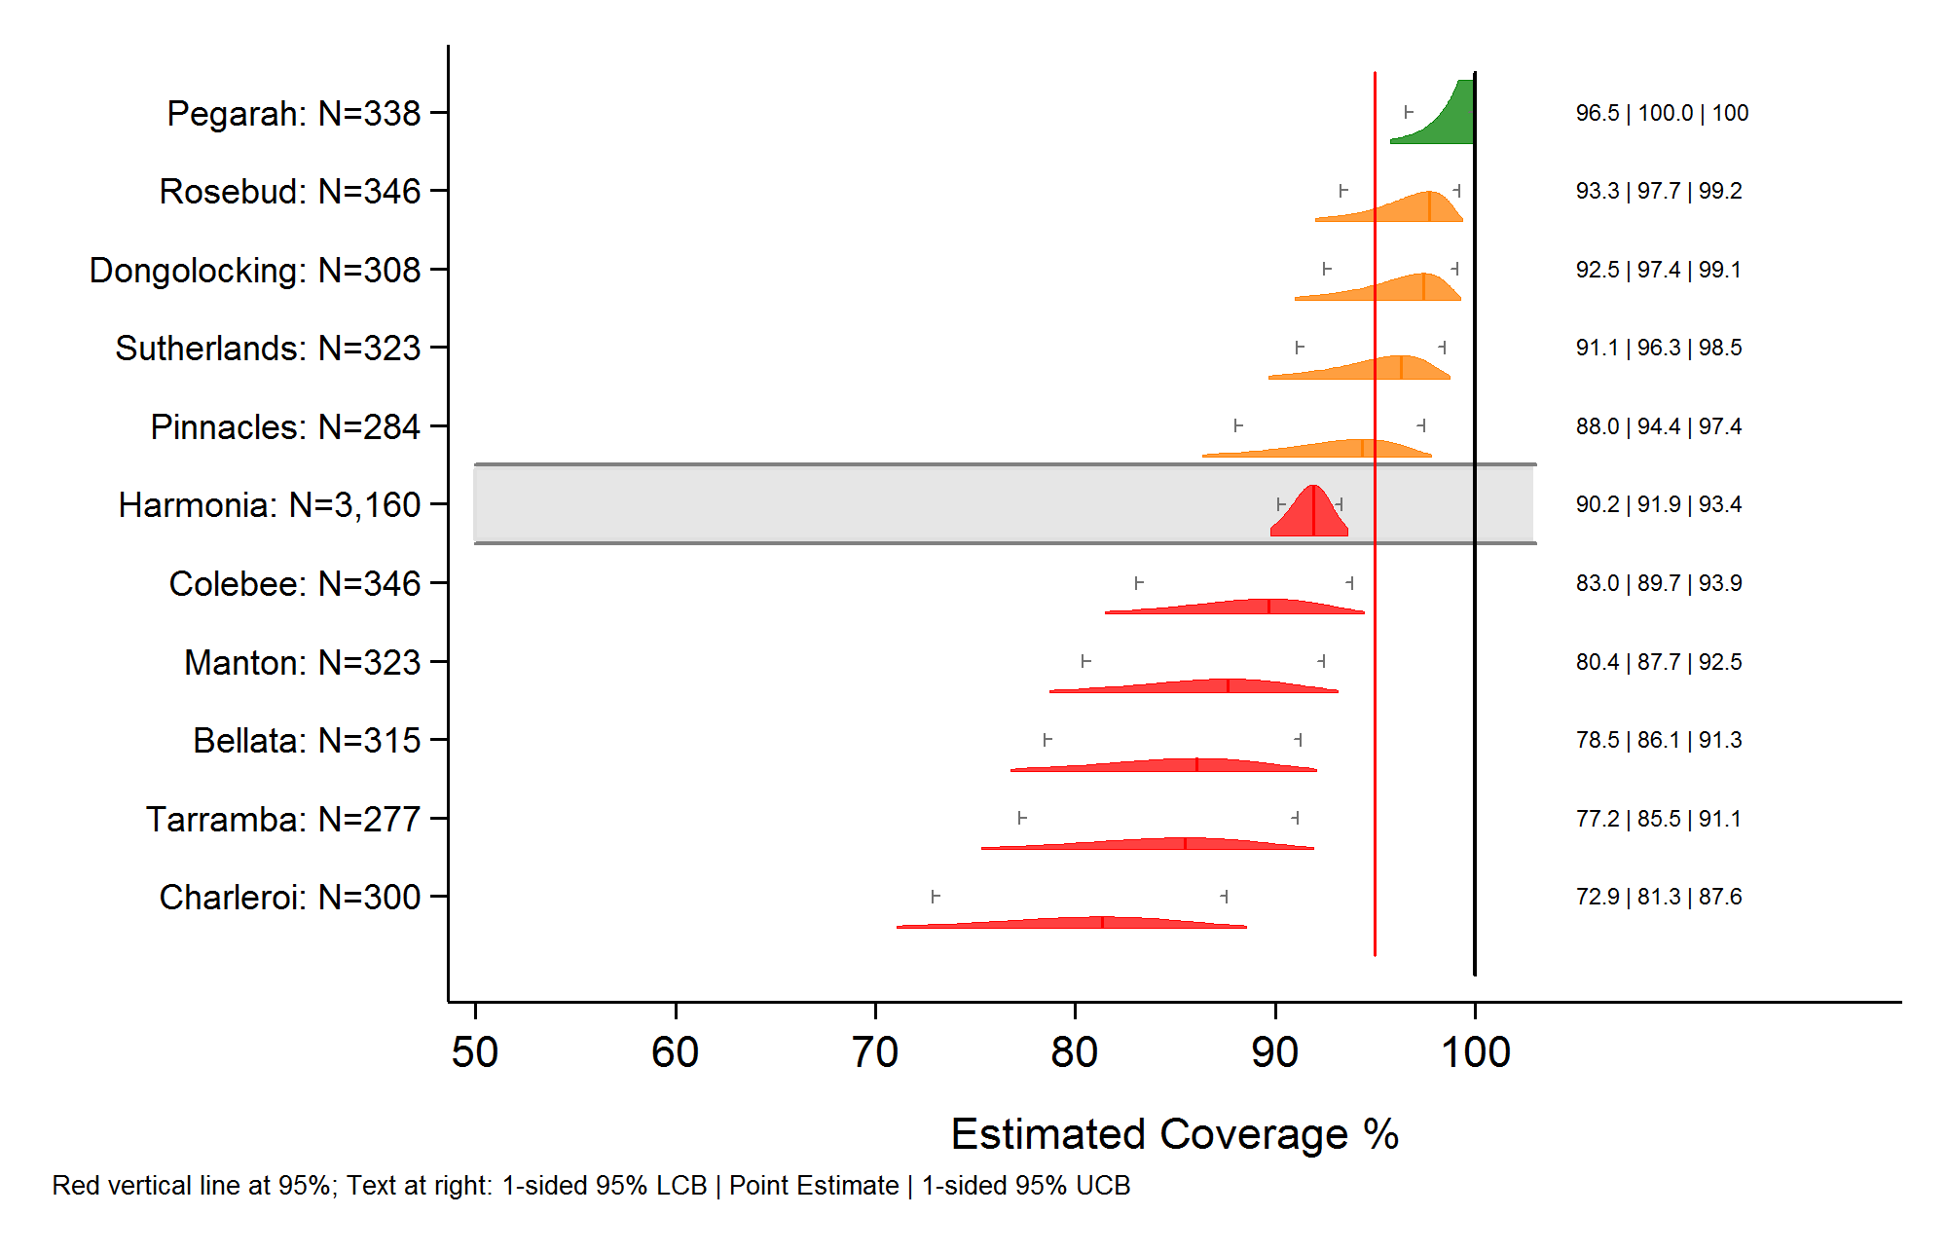
Our approach: inchworm plots
Notes:
Here is what we are proposing to use.
We show one ‘shape’ or ‘distribution’ for each stratum. The shape is clipped at the left and right to correspond to the 2-sided 95% CI. The point estimate is indicated with a subtle vertical bar. The gray tick marks show the lower and upper 1-sided 95% confidence bounds. The shapes are all scaled to have equal area. (Within the limitations of pixilation and the pixels included in the boundary of the shape as well as its interior.) The shaded row indicates that the one stratum represents the aggregate of all the other strata. The vertical red line is the target for coverage. The shapes are shaded to cateogorize the strata: green if the 1-sided lower bound is above 95%; red if the 1-sided upper bound is below 95%; orange if the 1-sided bounds straddle 95%.
In this plot the x-axis goes from 50 to 100%, but we often like to show the full range of 0-100%, as in the next slide.

Slide 10
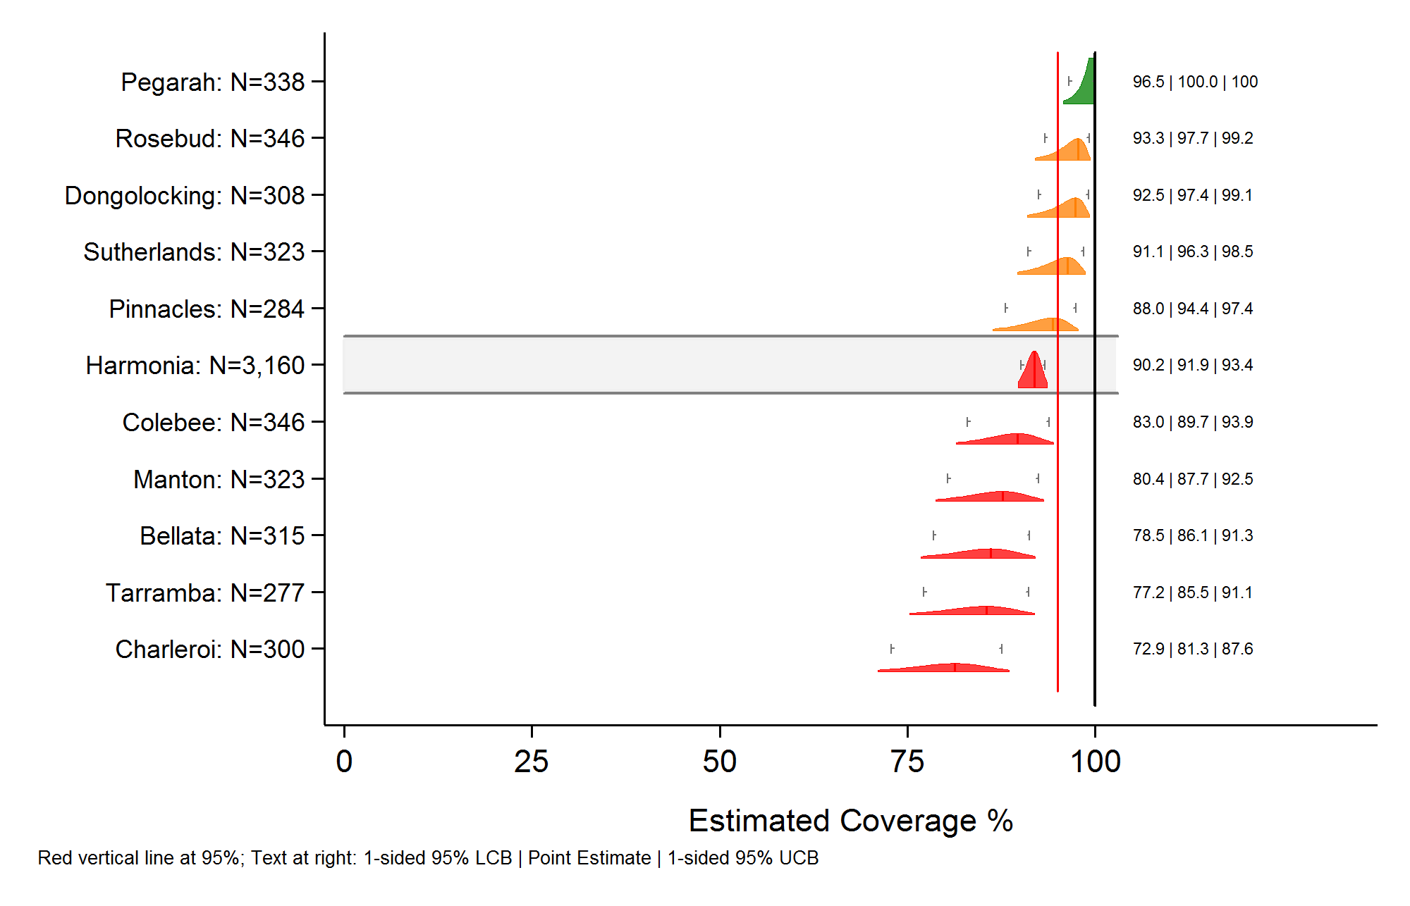
Rescaled to show 0-100%
Notes:
Showing the full range makes the shapes smaller and more cramped, but it puts the results in context. Showing percentages on the 0-100% scale consistently means that our readers do not need to re-orient horizontally with different plots, which hopefully aids their interpretation of the results.

Slide 11
Features
2-D representation of confidence intervals
Extend to 99.98% or clip at any CI width (often 95%)
Tick marks at one-sided bounds aid classification
Equal area
Sort by coverage
Use color or line pattern to convey meaning
May display more than one distribution per row
Notes:
These features are controllable with the command to make the plots
The distributions can be clipped or not clipped
The tick marks can be omitted or moved to some other bound
The sorting and coloring and line patterns are all user-specifiable
Whether you show one or more distributions per row is user-specifiable

Slide 12

1-D representation
A 1-D representation (projection) shows a single CI
A 2-D representation shows many simultaneously
2-D reveals what was being projected, lifting the veil and the cognitive burden of guessing the shape
In a 2-D representation, there is a loose sense in which we might say that the population parameter is equally likely to fall on any one pixel of ink in the distribution
If the interval is Bayesian, then it is a strong rather than a loose sense…

Slide 13

2-D representation
Emphasize that values near the point estimate are more likely than those near the ends of the CI
Emphasizes asymmetric nature of CIs near 0% & 100%
25% of the full distribution fall within the 25% CI
50% of the full distribution falls within the 50% CI
Ditto 75% … 95% … 99.98% …
Usually clipped to show only the 95% CI
Notes:
The shape is essentially a set of stacked confidence intervals ranging from 95% at the widest to 0.01% at the most narrow (at the top of the distribution). The intervals are spaced vertically so that the shapes all have the same area. Let’s call the area of each shape 0.95 units. If all the color within the 95% CI is 0.95 area units, then all the color within the 50% CI is 0.5 area units…and all the color within the 10% CI is 0.1 area units.

Slide 14
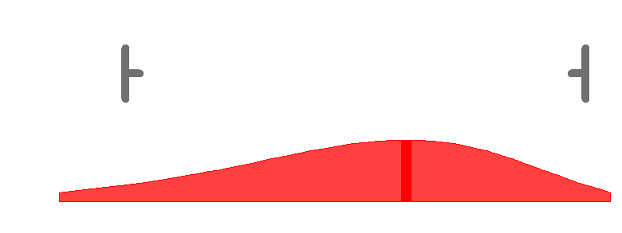
One-sided bounds for classification
Optional tick marks show 1-sided bounds
Usually at 95% lower & 95% upper confidence bounds (LCB & UCB)
Facilitates classification with respect to any threshold
Notes:
I suggest that if readers want to draw a strong conclusion about whether the outcome is likely to be above or below a programmatic threshold, they should compare the lower or upper 1-sided bounds with that threshold. If the lower 1-sided bound is above the threshold then it is quite likely that the population parameter is above the threshold. (Subject to all the normal caveats about absence of bias in the survey and having a true probability sample in the dataset and an appropriately weighted analysis.) If the upper 1-sided bound is below the threshold then it is quite likely that the population parameter is below the threshold. These are strong conclusions for classification.
If the threshold falls between the 1-sided bounds then you would need a larger sample to draw a strong conclusion about whether the population parameter is above or below the threshold.

Slide 15
Equal area
Notes:
It might be disappointing to not be able to confidently classify the orange strata here as being above or below the threshold, but one can still say a lot about them. The coverage in those strata is probably higher than that in the red strata, so if resources will be allocated to fix problems, address the red strata first. If it is imperative to know whether coverage is above or below 95%, then go back and enlarge the sample in the orange strata, or (and I do not recommend this) adopt a classification rule that provides weaker conclusions.

Slide 16
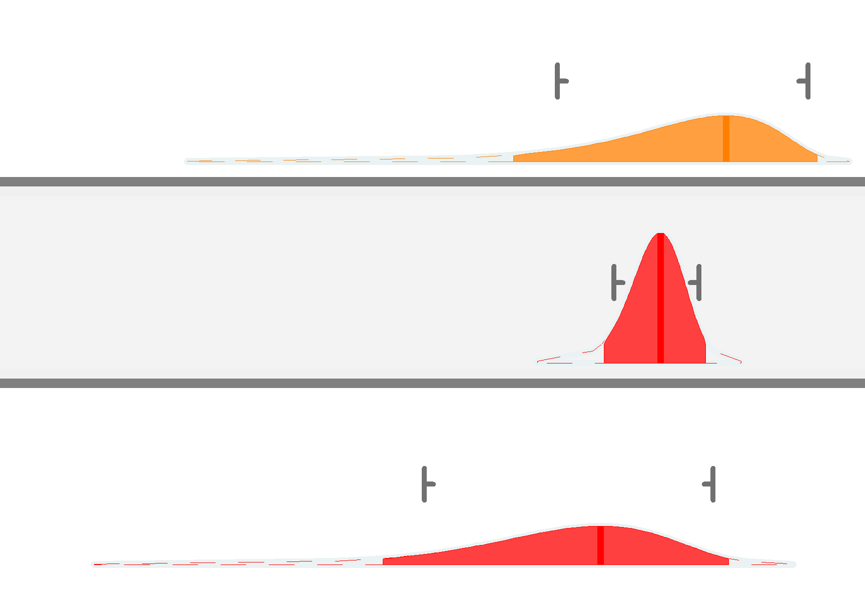
Zoom & show 99.98% distributions
Note: It is the equal-area scaling that makes some distributions tall and some short…hence the inch-worm analogy
Notes:
This figure shows the unclipped distributions that go out to the 99.98% CI and the clipped distributions that extend only to the 95% CI.
Of course for a proportion, we know that the 100% CI extends all the way from 0% to 100%. If we draw a line all the way across the plot, then the area of that line…even if it is only 1 pixel tall, will be quite large compared to the area of the rest of the distribution. Conceptually, the unclipped distribution goes all the way across the plot, but we cannot show equal areas if we try to do that with ink on a moderately sized screen or piece of paper. So even if clipping is turned off, the full distribution is really the 99.98% CI for these plots and this implementation.

Slide 17
Transparent classification
When we show the distribution and describe the classification rule, the strengths & weaknesses of the rule become quite transparent…
Readers can see how your rule relates to what the survey tells them about the population proportion
They can
follow your rule
evaluate your rule
or apply their own

Slide 18
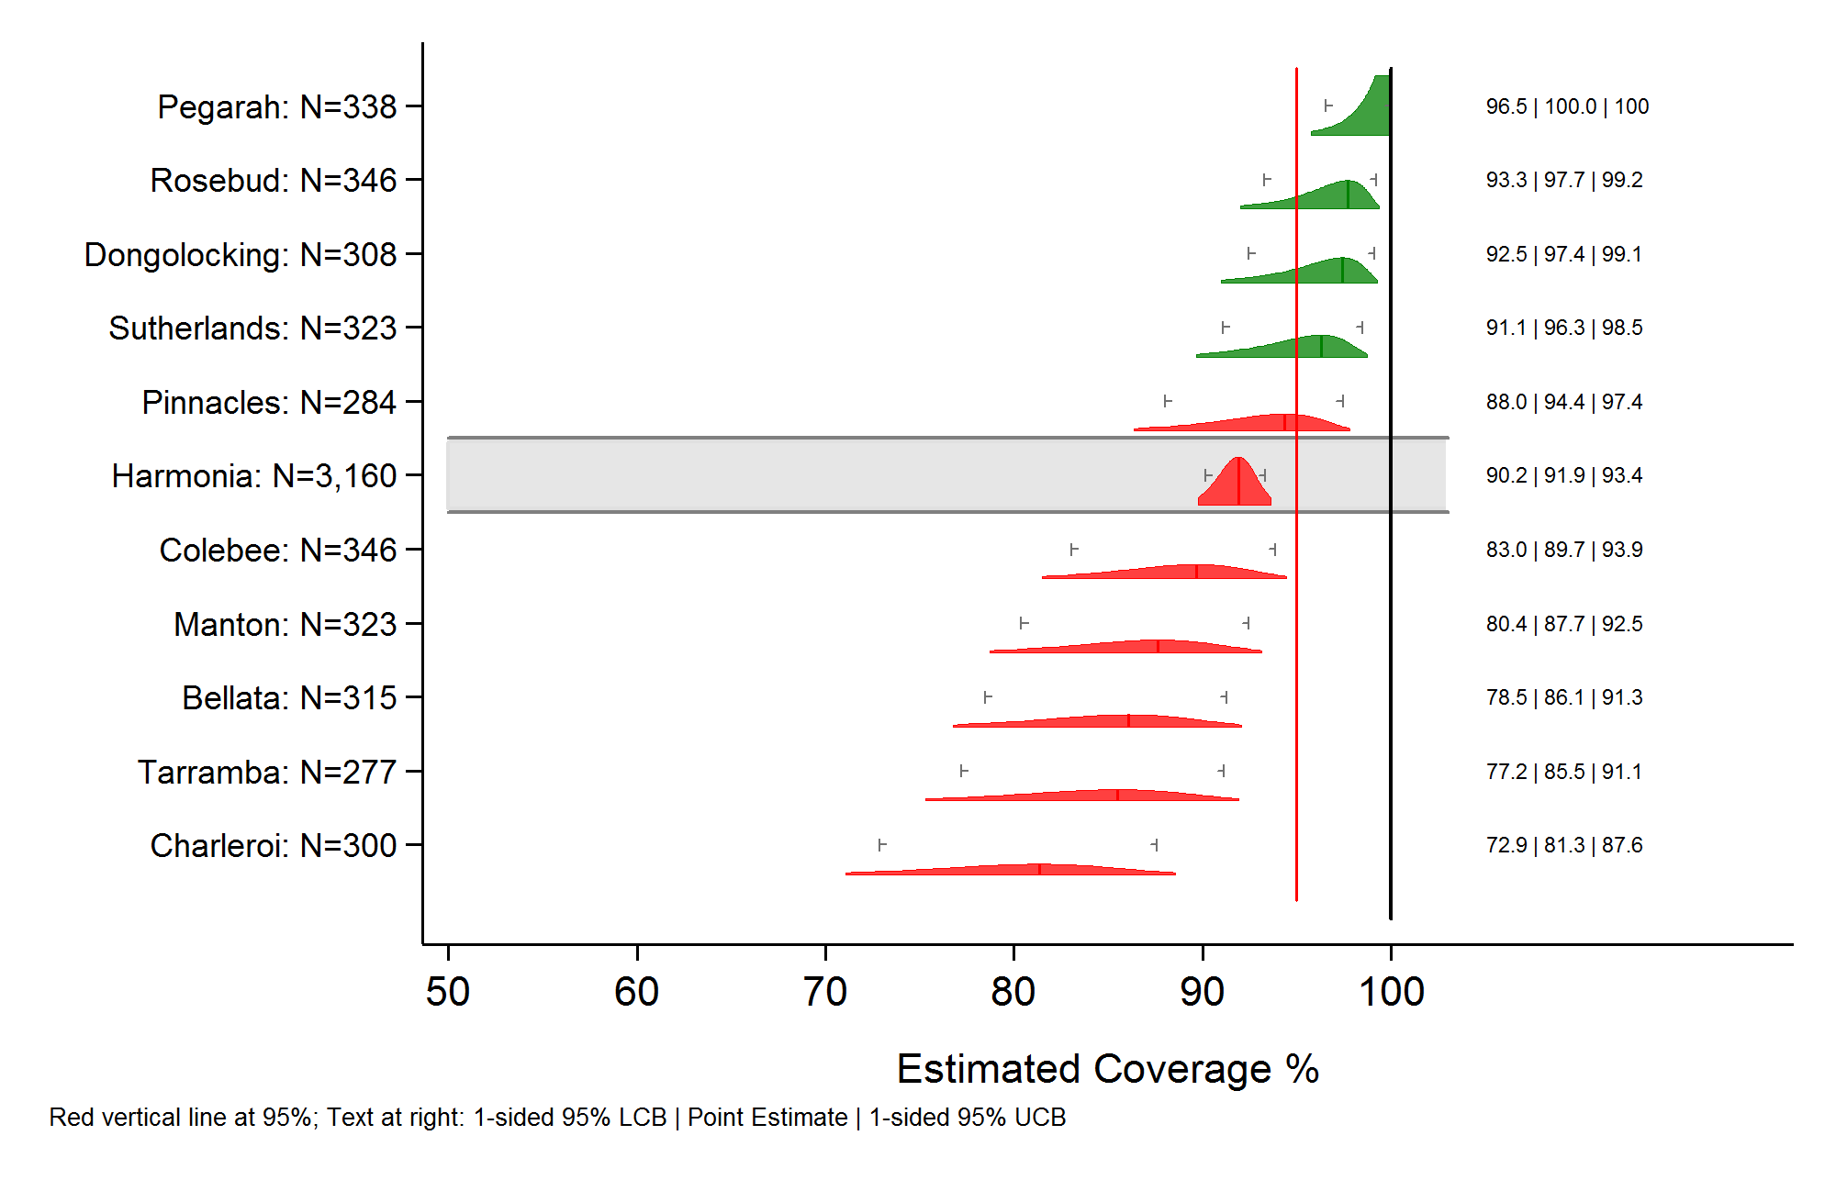
Classify using the point estimate
Notes:
Many policy-makers want to classify the outcome…pass/fail, good enough/not, high/low.
Here is a classification rule that provides relatively weak conclusions…not taking sampling variability into account:
Classify the stratum as a ‘pass’ (green) if the point estimate is ≥ the threshold of 95%.
Otherwise classify it as a ‘fail’ (red).

Slide 19
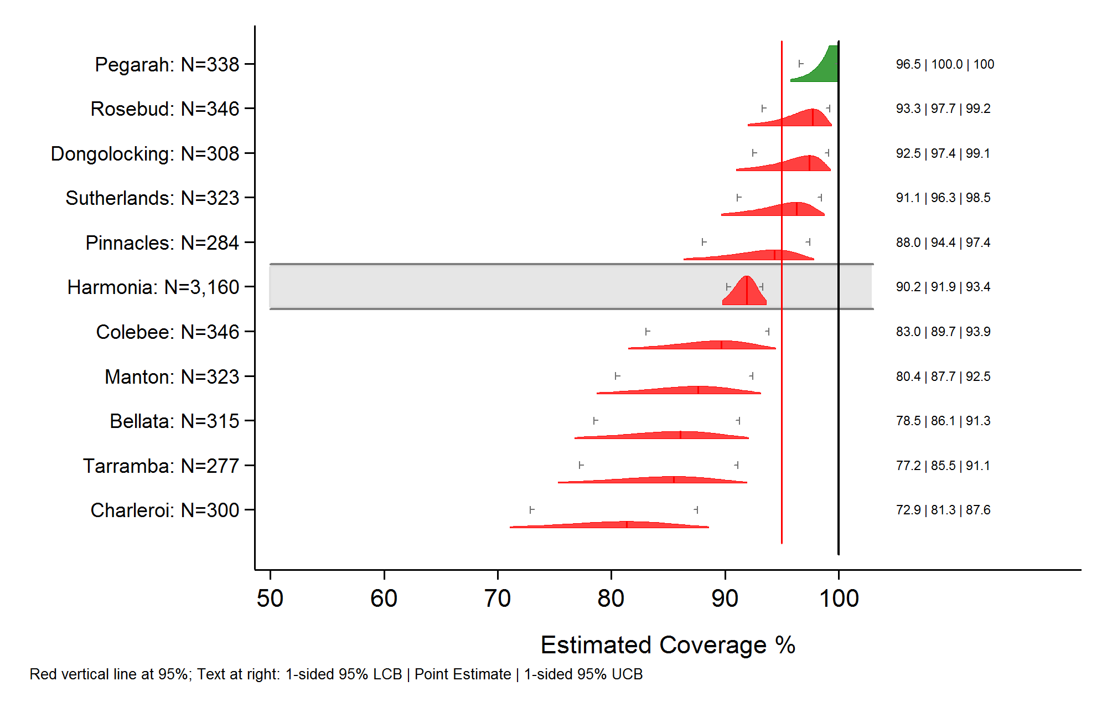
Classify using the 1-sided LCB
Notes:
Here is a classification rule that provides one strong conclusion and one weak conclusion:
Classify the stratum as a ‘pass’ (green) if the 1-sided lower confidence bound (LCB) is ≥ the threshold of 95%. (strong conclusion)
Otherwise classify it as a ‘fail’ (red). (weaker…at least it is weak with respect to whether coverage is likely below 95%...we can’t say that…we can just say that we are not super confident that it is above 95%)
But this rule tends to be depressing because most strata ‘fail’. And note that the hard-working folks in Rosebud receive the same classification as those in Charleroi. So maybe they stop trying so hard. This rule is clear and has strong conclusions, but can be demoralizing.

Slide 20

Classify using the 1-sided UCB
Notes:
Here is a complementary rule that provides one strong conclusion and one weak conclusion:
Classify the stratum as a ‘fail’ (red) if the 1-sided upper confidence bound (LCB) is ≤ the threshold of 95%. (strong conclusion)
Otherwise classify it as a ‘pass’ (green). (weaker…at least it is weak with respect to whether coverage is likely above 95%...we can’t say that…we can just say that we are not super confident that it is below 95%)
This rule yields more ‘passes’ than the prior one, but the ‘pass’ is less meaningful. We can be 94% confident that coverage is below the threshold and the stratum will still pass.
Surprisingly, this rule shows up in practice…and when it does it is often described misleadingly as providing strong conclusions…but only one conclusion is strong here.

Slide 21
Classify using both UCB & LCB
Notes:
If you want two strong conclusions, I recommend using a 3-level classification. Green means the 1-sided LCB is above the threshold…this is a strong conclusion. Red means the 1-sided UCB is below the threshold…this is also a strong conclusion. Orange means the LCB and UCB straddle the threshold. No strong conclusion can be made with respect to the threshold, but the orange strata can often be classified as likely having coverage that is neither the best nor the worst, so for triaging purposes they are not the biggest concern. If more certainty is needed then a supplementary sample can be drawn.
Note that with this representation, if you decide to classify with respect to a different threshold, you need only to draw a new vertical line on the plot and judge where the LCB and UCB fall with respect to it. So different policymakers with different concerns or goals can use the same plot to classify. Also, if you show the shapes and LCB and UCB then you can ignore how someone else has colored the distributions and you can come up with your own classification rule for your purposes.
In short, this representation portrays where your confidence should lie with respect to likely values of the population parameter. In strata with large samples or homogeneous outcomes, the distributions are narrow…in strata with smaller strata, the distributions are wide…this is a point that is lost in reports that only show the point estimates and sample sizes.

Slide 22
The program iwplot_svyp.ado
Available at https://github.com/BiostatGlobalConsulting/inchworm-plots-stata
Available soon within Stata: findit iwplot
Notes:
The earlier slides discussed the motivation for inchworm plots and some features you can convey with them and why we prefer them to 1-dimensional representation of confidence intervals.
But how do you make them?
The new Stata command is available from our Github site and will soon be available via the SSC from within Stata.

Slide 23
iwplot_svyp.ado
A big graphical wrapper for svy: proportion
Plot controlled by five datasets
Distribution info (required)
Vertical lines
Horizontal lines
Text
Arrows
Plus some command line options
Titles, axes, naming, saving, exporting, etc.
Notes:
Before you call the command iwplot_svyp, your software must generate between one and five datasets to control the features of the plot.
The required dataset contains one row per distribution…it specifies things like which row the distribution will appear on, the color of the distribution, whether the distribution is clipped, the text to appear at right and left, and whether to shade the row behind the distribution.
If you wish to overlay vertical lines, then their properties go into a separate dataset
If you wish to overlay horizontal lines, then their properties go into a separate dataset
If you wish to overlay text on the figure, then the textbox text and properties go into a separate dataset
And if you wish to overlay arrows, then their properties go into yet another separate dataset
Finally, the iwplot_svyp command has some command line options to control plot-level characteristics – many are standard twoway options

Slide 24
Call the program
Either as part of analysis on-the-fly
You write a wrapper that looks at results and writes dataset(s)
Wrapper calls the iwplot_svyp.ado program
Or post-hoc, one plot at a time
Use Stata to generate the datasets & call program
Or put dataset info in Excel template by hand (6 tabs)
Call excel_wrapper_for_iwplot_svyp.ado
Converts tabs to datasets and calls iwplot_svyp
Notes:
In our work we embed iwplot_svyp in a larger suite of software that evaluates results and prepares those datasets automatically and calls iwplot_svyp. Sometime it makes dozens of inchworm plots in a single run, applying pre-coded rules for coloring and ordering the distributions
In other instances (e.g., in preparation for this talk) we hand-craft these plots…specifying every detail as an example…in that instance we can build the datasets using Stata, or we can enter the relevant info into an Excel template and call a wrapper that reads Excel and then writes Stata datasets and then makes the plot.
When you download the package from the Github site you can see the Excel files we used to make most of the figures for this talk. You can reproduce them by calling the Excel wrapper program. If you change the values in the Excel template, you can make your own customized inchworm plots by calling the wrapper program in Stata after you save your changes in Excel.

Slide 25
2 ways to specify distribution info
Stipulate, for each distribution:
Name of dataset
svyset syntax
Outcome variable (coded 0/1/.)
Syntax to identify domain (e.g., if district_id == 6)
Or specify
Estimated proportion (from earlier svy: proportion run, or from report table)
Effective sample size
For purposes of plot-making, these two options are very nearly equivalent…
Notes:
Consider for a moment an individual distribution in one of the plots. What do you need to tell Stata to have it be able to calculate the outside boundary of what we might call that confidence distribution? There are two options:
If you have the survey sample dataset available, then you just tell iwplot_svyp where the dataset lives, the svyset command, the name of the variable, and how to restrict attention to the stratum or domain of interest. This is done via four variables in the dataset with distribution info.
But what if the original dataset is not available? (e.g., you want to make an inchworm plot based on tabular output from a report?) Well then you tell Stata the estimated proportion and the effective sample size in that stratum. (Note…you need the effective sample size, not the full sample size…so hopefully the report told you the design effect).

Slide 26
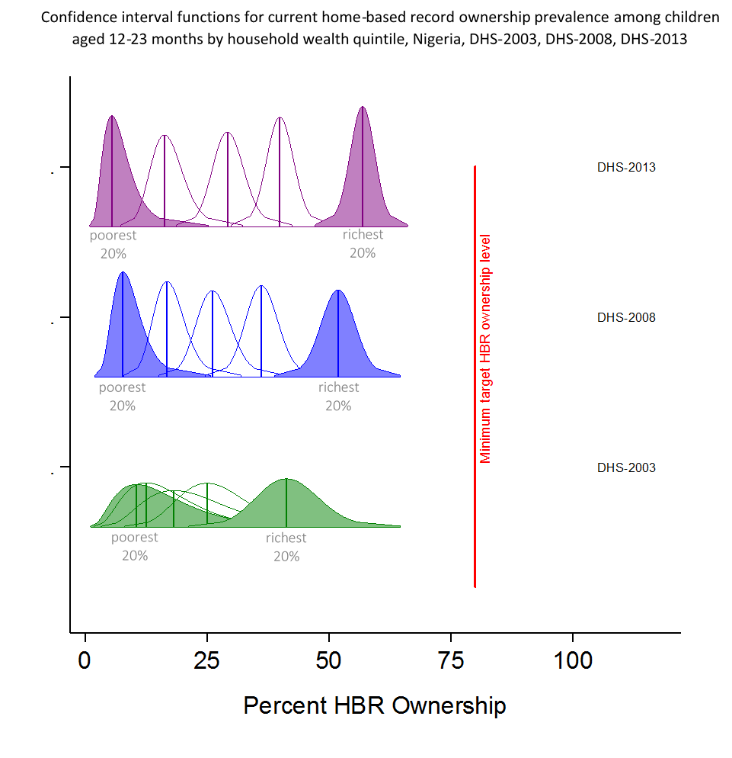
Example: 2+ distributions per row & added text
Courtesy of David Brown at Brown Consulting Group
Notes:
This figure shows an example of more than one distribution per row and an example of overlaying text and a vertical line.

Slide 27
Example
Be sure to see the tall poster of results from 90+ strata in Ethiopia during the break
Notes:
At the Stata conference, I brought a 5 foot tall poster showing results from more than 90 strata in a 2013 survey in Ethiopia.

Slide 28
Context revisited
Although we have focused on complex sample survey inference for proportions, especially among nested strata, the ideas here are applicable for other types of inference
The program is written to portray results from survey proportions, but the ideas could be adapted for other outcomes & settings
Notes:
This program has some features that are hard-wired for proportions and for survey data, but the same visualization ideas could be used for other outcomes (totals or means) and for other types of sampling…it wouldn’t need to be a complex survey.

Slide 29
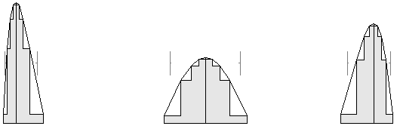
Conclusions
Inchworm plots portray what can be inferred about population proportions from unbiased survey data
They provide a transparent basis for classifying population proportions
They lend themselves to 3-category classification, which may be preferable to 2-category systems, especially when ESS is small
They nicely illustrate relationships between nested strata
After a short orientation, they may be easily interpreted by clients and preferable to tabular output alone and to bar charts

Slide 30
Acknowledgements
This work has been supported by funding and input from dedicated public health professionals at the Bill & Melinda Gates Foundation and the World Health Organization
Our ideas have been shaped and sharpened by others who interact with consumers of survey data including: David Brown, Tony Burton, Pierre Claquin, Felicity Cutts
Several programmers have worked on different aspects of the code and help files: Mary Prier, Yulia Fungard, Mary Kay Trimner and myself

Slide 31
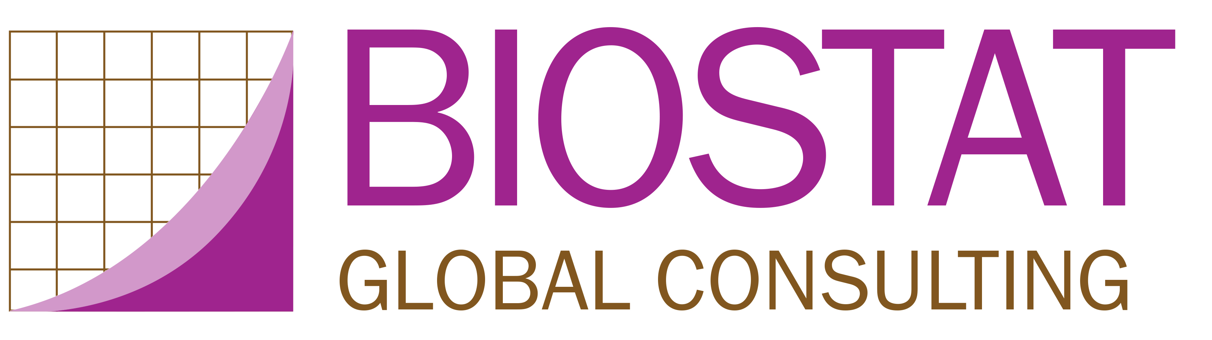
Questions?
Dale.Rhoda@biostatglobal.com
+1 614 499-2351

Slide 32
Additional slides

Slide 33
What about the bar scene?
Q: But isn’t it sufficient to simply show a bar chart where the bar extends from 0% up to the estimated proportion and then a 1-dimensional error bar illustrates the 95% CI? This is easy to do in Excel.
A. No…I suggest that the bar chart representation is inferior for lots of reasons.
In the current issue of The American Statistician, Pentoney & Berger reproduce and extend earlier findings showing that people are more likely to perceive that the population figure could fall in the portion of the CI that lies within the bar than in the portion that falls outside the bar…

Slide 34
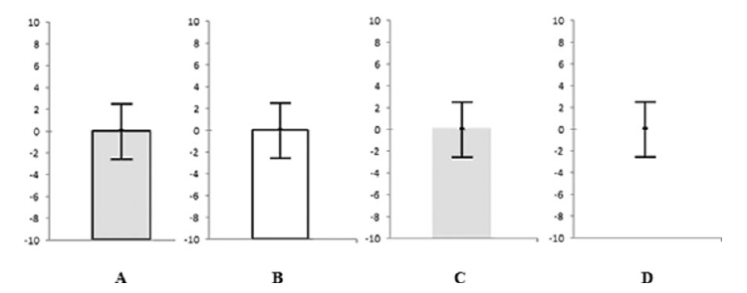
Pentoney & Berger, 2016 figure

Slide 35
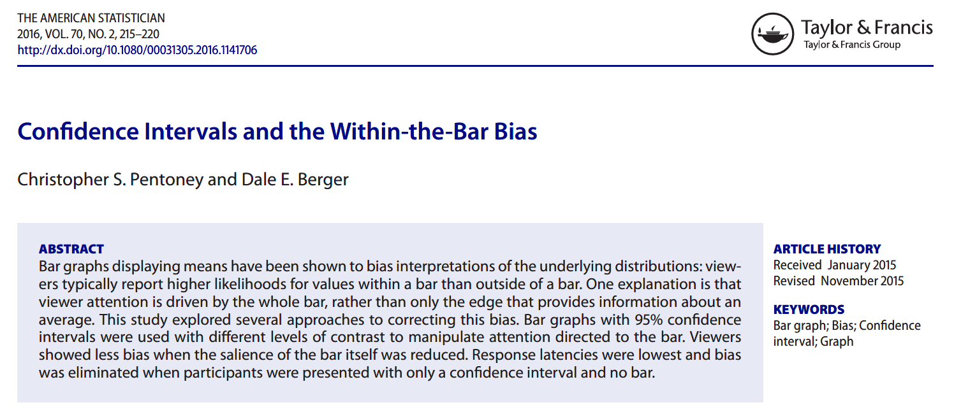
Pentoney & Berger 2016 citation

Slide 36
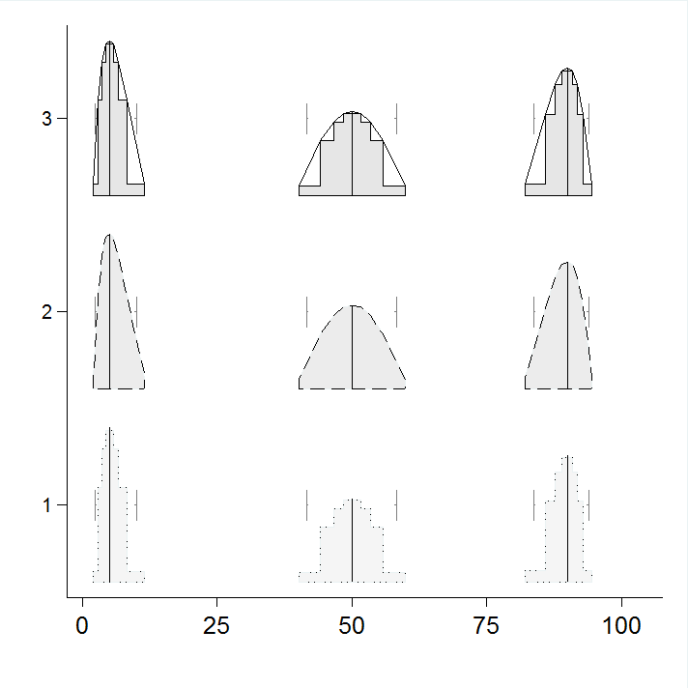
5 rectangles per distribution
Notes:
This figure shows the building blocks of the distributions. The program estimates several confidence intervals (user-specifiable number) and then calculates a set of y-coordinates that give them the equal-area property. Finally the distribution connects the points of the outer corners of the confidence rectangles.
In this plot, each distribution calculates 5 CIs. The narrowest is too narrow to see here with your eye. It is the 0.01% CI. The widest is the 95% CI. You can see four nested rectangles, and there is a fifth at each point estimate that is too narrow to see. The program gives the user the option to plot the stair steps, the bounding distribution polygon, or both.

Slide 37
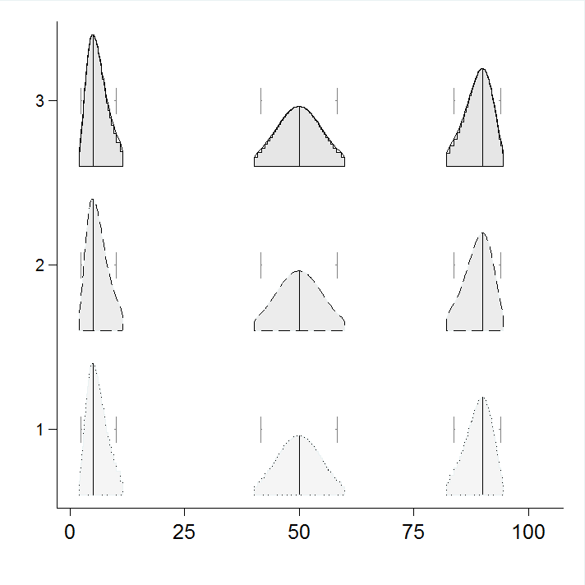
30 rectangles per distribution
Notes:
Here are the same distributions, but now calculated with 30 CIs instead of 5.

